Slide 1
Photographic Identification of Sea Turtles
using Python and OpenCV
Natapon Pantuwong
PyCon2018, Bangkok
This slide can be found at https://github.com/pantuwong/pycon2018.git

Slide 2


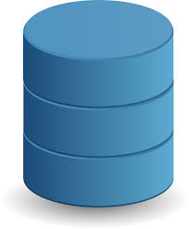
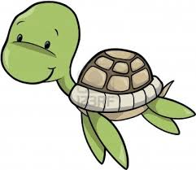
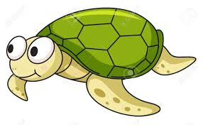
What’s photo identification for sea turtle

Slide 3
Why I come with this system
I have a friend who works at Sea Turtle Conservation Center
Main mission are captive-rearing and release of turtle hatchlings
He needs to track the released turtles when they are found again
With statistical data, we can analyze the population of sea turtle and plan how can we protect them

Slide 4
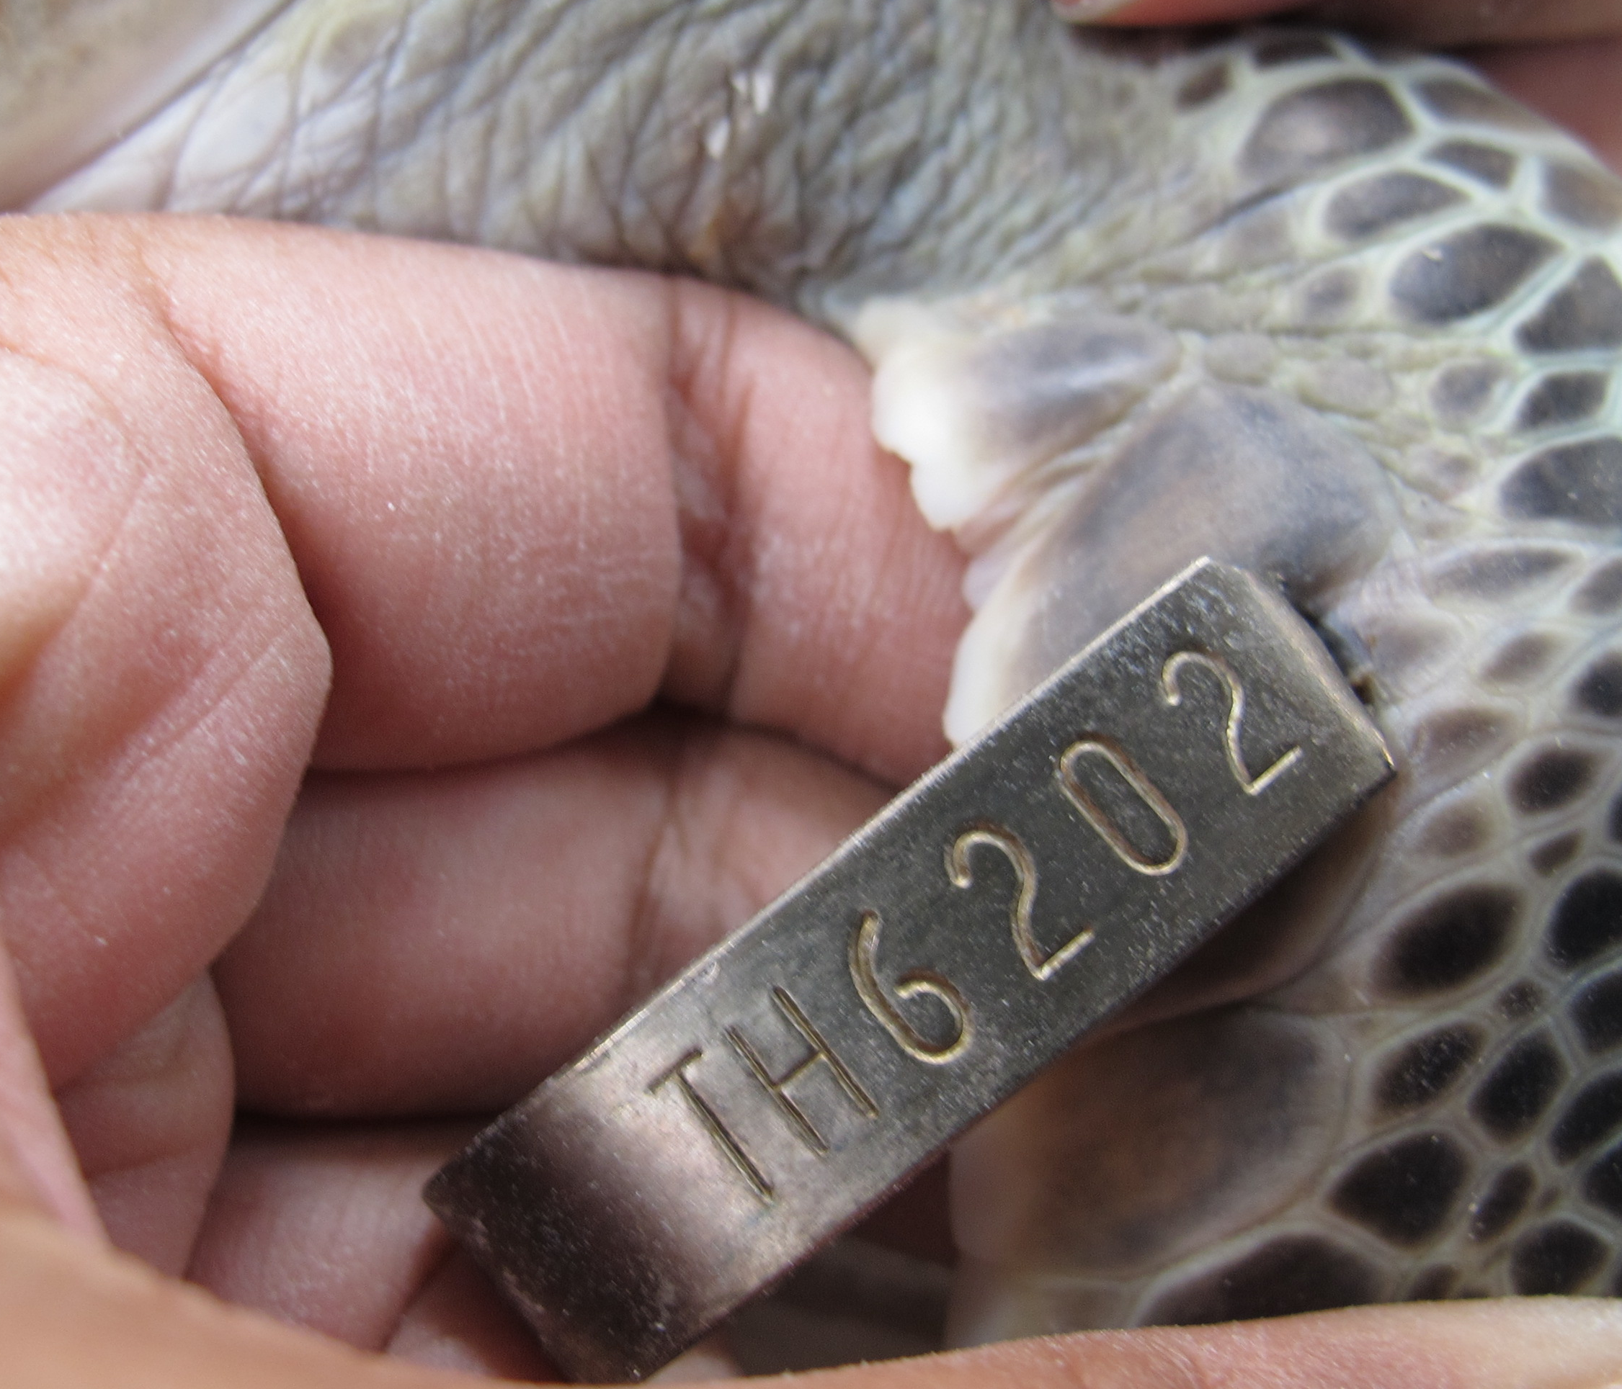
Why I come with this system (con’t)
Normally, my friend uses a tag attached to sea turtle, but it is not the best solution.
When a turtle go into the ocean, it might be attacked and the tag might be lost
It is easier, if we can just take its photo, and identify it with our database

Slide 5
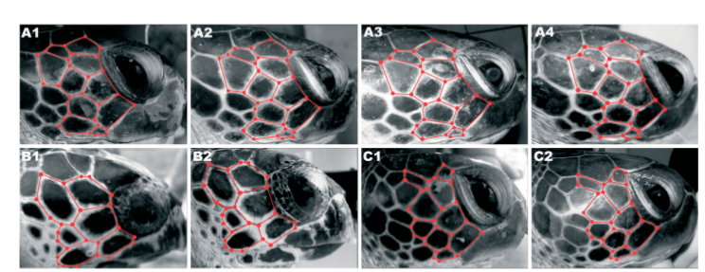
How can we identify a sea turtle using photo
Sea turtles have a unique pattern of facial scutes
These photos have been taken in different time during 3 years

Slide 6
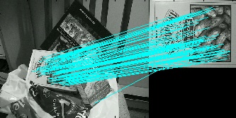
How can we identify a sea turtle using photo
So, identifying sea turtle could be solved by using image ( of facial scute ) matching
A good algorithm to start is SIFT by Prof.David Lowe

Slide 7
How Python and OpenCV do SIFT
SIFT feature extraction
# Initiate SIFT detector
sift = cv2.SIFT()
# find the keypoints and descriptors with SIFT
kp1, des1 = sift.detectAndCompute(img1,None)
kp2, des2 = sift.detectAndCompute(img2,None)

Slide 8
How Python and OpenCV do SIFT
SIFT feature matching
# BFMatcher with default params
bf = cv2.BFMatcher()
matches = bf.knnMatch(des1,des2, k=2)

Slide 9
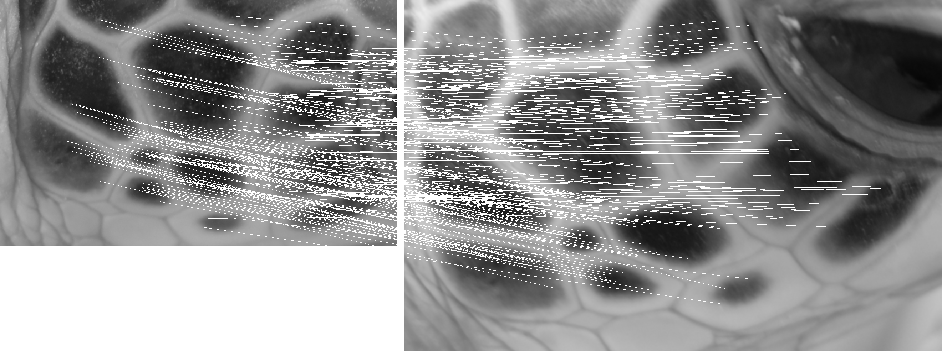
Results

Slide 10
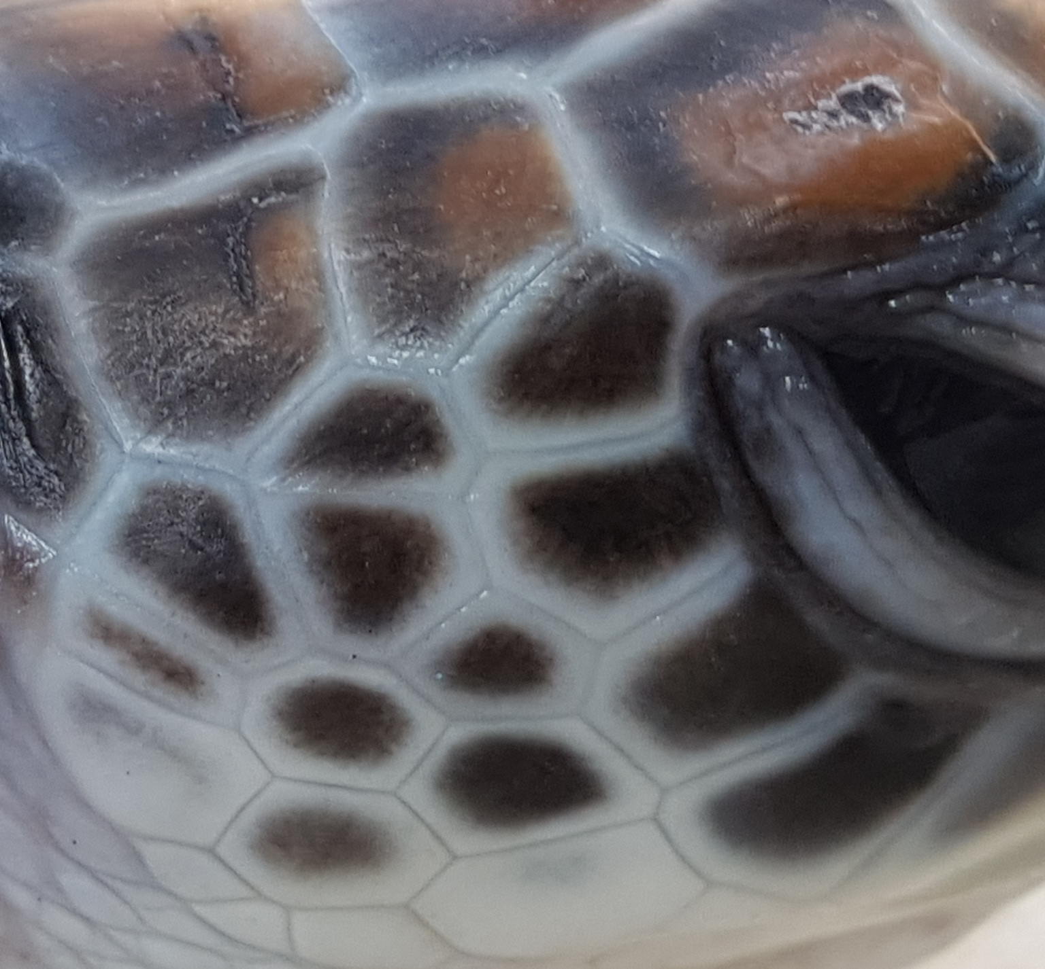
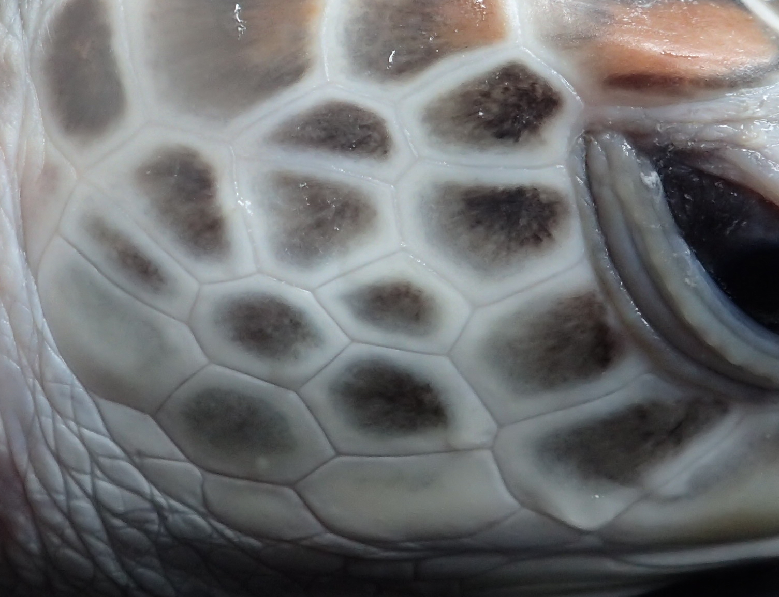
Is it promising method?
Unfortunately, it is not a promising method
SIFT it not invariant against color and intensity change
Scute pattern doesn’t change, but color change

Slide 11
Another idea to solve this problem
We need only information about scute pattern, not its color or intensity
Extract scute edge is not an easy problem
Need user involvement
User selects all corners of scutes
Create a mesh from all corner positions using Delaunay triangulation
Mesh matching by apply SIFT to mesh image

Slide 12
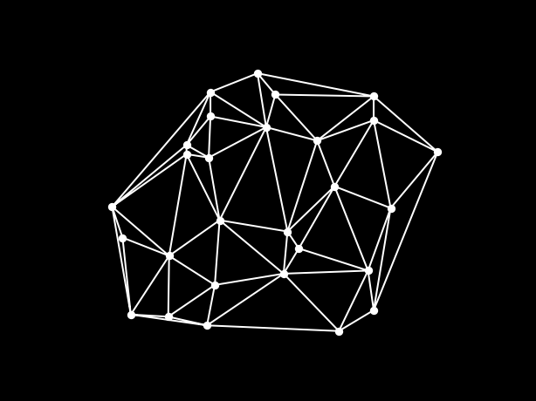
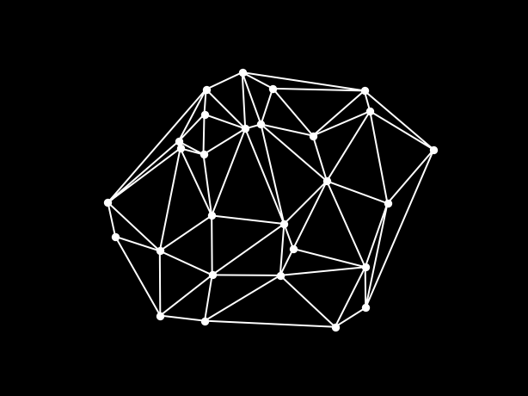
Example

Slide 13
Delaunay Triangulation with Python
Use Scipy to triangulate
>>> points = np.array([[0, 0], [0, 1.1], [1, 0], [1, 1]])
>>> from scipy.spatial import Delaunay
>>> tri = Delaunay(points)
Use Matplotlib to plot
>>> import matplotlib.pyplot as plt
>>> plt.triplot(points[:,0], points[:,1], tri.simplices.copy())
>>> plt.plot(points[:,0], points[:,1], 'o')
>>> plt.show()

Slide 14
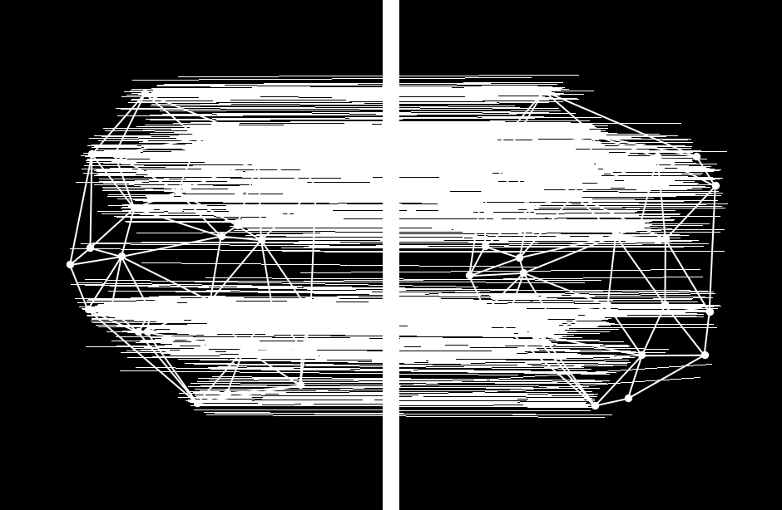
Result

Slide 15
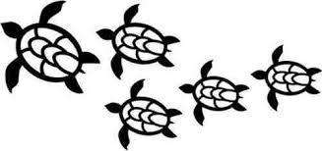
Let's conserve our sea turtles

